Slide 1
Linear Algebra and Probability for Computer Science Applications

Slide 2
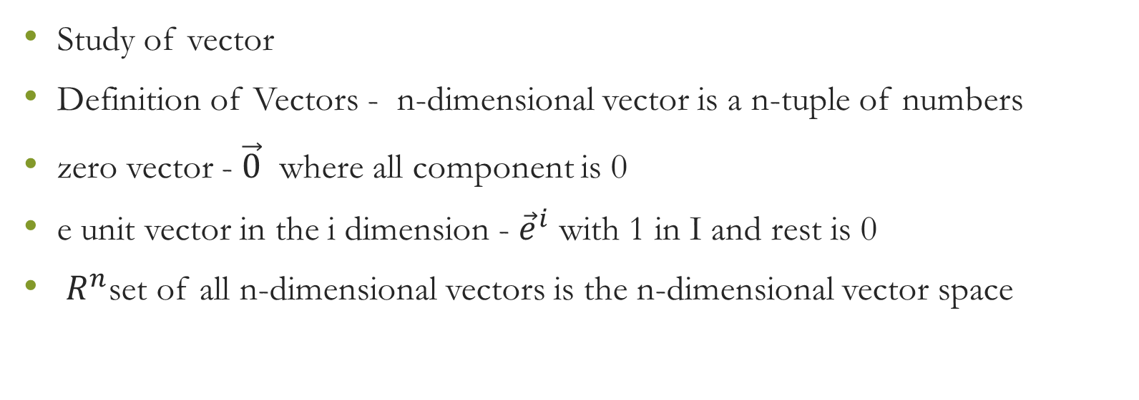
Linear algebra
Study of vector
Definition of Vectors - n-dimensional vector is a n-tuple of numbers
zero vector - $\vec{0}$ where all component is 0
e unit vector in the i dimension - ${\vec{e}}^{i}$ with 1 in I and rest is 0
$R^{n}$set of all n-dimensional vectors is the n-dimensional vector space

